Slide 1
The Design of the Tax System
CHAPTER 12
Notes:
N. Gregory Mankiw Principles Of Economics Eight Edition

Slide 2
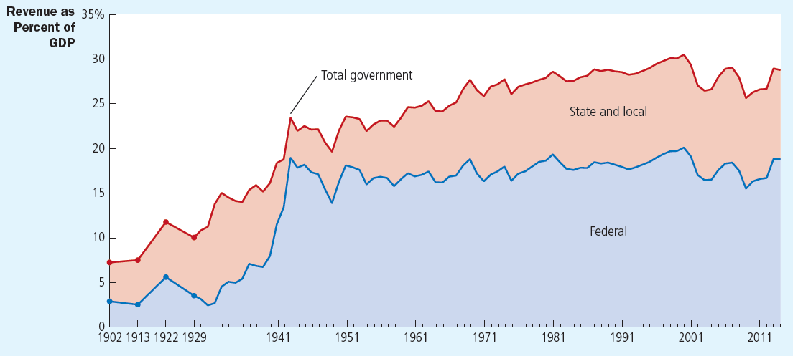
Figure 1 Government Revenue as a Percentage of GDP: Changes over Time, Part 1
This figure shows revenue of the federal government and of state and local governments as a percentage of gross domestic product (GDP), which measures total income in the economy. It shows that the government plays a large role in the U.S. economy and that its role has grown over time.

Slide 3
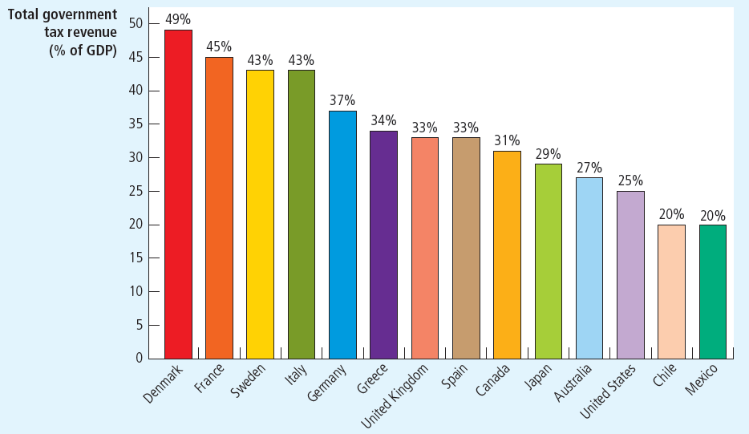
Figure 2 Government Revenue as a Percentage of GDP: International Comparisons, Part 2
The percentage of income that governments take in taxes varies substantially from country to country.

Slide 4
An Overview of U.S. Taxation, Part 1
Government revenue – increased
As percentage of total income
As economy’s income has grown
Government’s revenue from taxation has grown even more
As a nation gets richer
Government takes a larger share of income in taxes

Slide 5
Table 1 Receipts of the Federal Government: 2014
Tax | Amount (billions) | Amount per person | Percent of receipts
Personal income taxes | $1,397 | $4,379 | 45%
Social insurance taxes | 1,145 | 3,589 | 35
Corporate income taxes | 418 | 1,310 | 13
Other | 305 | 956 | 9
Total | $3,265 | $10,235 | 100%

Slide 6
An Overview of U.S. Taxation, Part 2
Taxes collected by federal government
Two-thirds of taxes in the economy
Total receipts: $3.3 trillion in 2014
$10,235 per person
Personal income taxes
Largest source of revenue
Based on total income (wages, interest, dividends, profits)
Marginal tax rate

Slide 7
An Overview of U.S. Taxation, Part 3
Marginal tax rate
Tax rate applied to each additional dollar of income
Rises as income rises, higher-income families pay a larger percentage of their income in taxes

Slide 8
An Overview of U.S. Taxation, Part 4
Taxes collected by federal government
Payroll taxes: a tax on the wages that a firm pays its workers
“Social insurance taxes” – pay for Social Security and Medicare
Social Security: income-support program for the elderly
Medicare: government health program for the elderly

Slide 9
Table 2 The Federal Income Tax Rates: 2014
On taxable income… | The tax rate is…
From $0 to %9,075 | 10%
From $9,076 to $36,900 | 15%
From $36,901 to &89,350 | 25%
From $89,351 to $186,350 | 28%
From $186,351 to $405,100 | 33%
From $405,101 to $406,750 | 35%
From $406,751 and above | 39.6%
This table shows the marginal tax rates for an unmarried taxpayer. The taxes owed by a taxpayer depend on all the marginal tax rates up to his income level. For example, a taxpayer with income of $25,000 pays 10 percent of the first $9,075 of income, and then 15 percent of the rest.

Slide 10
An Overview of U.S. Taxation, Part 5
Taxes collected by federal government
Corporate income tax: tax on profits
Corporation: business set up to have its own legal existence
Corporate profits are taxed twice
Corporate income tax when the corporation earns the profits
Individual income tax when the corporation uses its profits to pay dividends to its shareholders

Slide 11
An Overview of U.S. Taxation, Part 6
Taxes collected by federal government
Other taxes
Excise taxes: taxes on specific goods like gasoline, cigarettes, and alcoholic beverages
Estate taxes
Customs duties

Slide 12
An Overview of U.S. Taxation, Part 7
Taxes collected by state and local governments
About 40% of all taxes paid
$2,225 billion ($6,975 per person) in 2014
More than 40% of receipts are from sales taxes and property taxes
Sales tax
Percentage of total amount spent at retail stores

Slide 13
An Overview of U.S. Taxation, Part 8
Taxes collected by state and local governments
Property taxes
Percentage of estimated value of land and structures – paid by property owners
Individual and corporate income taxes

Slide 14
An Overview of U.S. Taxation, Part 9
Taxes collected by state and local governments
Funds from the federal government
Redistributes funds from high-income states (which pay more taxes) to low-income states (which receive more benefits)
Other receipts
Fees for fishing and hunting licenses;
Tolls from roads and bridges
Fares for public buses and subways

Slide 15
Table 3 Receipts of State and Local Governments: 2014
Tax | Amount (billions) | Amount per person | Percent of receipts
Sales tax | $525 | %1,646 | 24%
Property taxes | 456 | 1,429 | 20
Personal income taxes | 383 | 1,201 | 17
Corporate income taxes | 58 | 182 | 3
Federal government | 495 | 1,552 | 22
Other | 308 | 966 | 14
Total | $2,225 | $6,975 | 100%

Slide 16
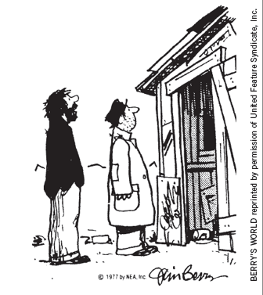
Taxes and Efficiency, Part 1
Policymakers
Equity and efficiency
Costs of taxes to taxpayers
Tax payment itself
Deadweight losses
Taxes distort the decisions that people make
Administrative burdens
Taxpayers bear as they comply with the tax laws
“I was gonna fix the place up, but if I did, the city would just raise my taxes!”

Slide 17
Taxes and Efficiency, Part 2
Efficient tax system
Small deadweight losses
Small administrative burdens
Deadweight losses
People respond to incentives
Government – tax a good
People buy less of it
Taxes – distort incentives

Slide 18
Taxes and Efficiency, Part 3
Deadweight losses
Reduction in economic well-being of taxpayers
In excess of the amount of revenue raised by the government
Inefficiency
People allocate resources according to the tax incentive
Not according to true costs and benefits

Slide 19
Taxes and Efficiency, Part 4
Tax a good
Consumer surplus drops
Tax revenue increases
Decrease in consumer surplus > increase in tax revenue
Deadweight loss

Slide 20
Should income or consumption be taxed?, Part 1
Taxes: induce people to change their behavior
Deadweight losses
Less efficient allocation of resources
Current tax system: Individual income tax
Tax the amount of income people earn
Discourages people from working as hard
Discourages people from saving

Slide 21
Should income or consumption be taxed?, Part 2
Changing the basis of taxation
Eliminate disincentive toward saving
Consumption tax
Tax the amount that people spend
Income saved – not be taxed until the saving is later spent
Not distort people’s saving decisions

Slide 22
Should income or consumption be taxed?, Part 3
European countries
Rely more on consumption taxes than does the U.S.
Value-added tax (VAT)
Tax is collected in stages as the good is being produced

Slide 23
Taxes and Efficiency, Part 5
Administrative burden
Time spent to fill out forms
Time spent throughout the year keeping records for tax purposes
Resources the government has to use to enforce the tax laws
Tax lawyers and accountants
Legal tax avoidance

Slide 24
Taxes and Efficiency, Part 6
Administrative burden
Resources devoted to complying with tax laws
Deadweight loss
Can be reduced – simplify the tax laws
Politically difficult

Slide 25
Taxes and Efficiency, Part 7
Average tax rate
Total taxes paid divided by total income
Sacrifice made by a taxpayer
Fraction of income paid in taxes
Marginal tax rate
The extra taxes paid on an additional dollar of income
How much tax system distort incentives
Determines the deadweight loss

Slide 26
Taxes and Efficiency, Part 8
Lump-sum taxes
Same amount of tax for every person
Most efficient tax possible
A person’s decisions do not alter the amount owed
Doesn’t distort incentives
Doesn’t cause deadweight losses
Imposes a minimal administrative burden
No equity

Slide 27
Taxes and Equity, Part 1
The benefits principle
People should pay taxes based on the benefits they receive from government services
Tries to make public goods similar to private goods
A person who gets great benefit from a public good should pay more for it than a person who gets little benefit

Slide 28
Taxes and Equity, Part 2
The ability-to-pay principle
Taxes should be levied on a person according to how well that person can shoulder the burden
Vertical equity
Taxpayers with a greater ability to pay taxes should pay larger amounts
Richer taxpayers should pay more than poorer taxpayers
How much more should the rich pay?

Slide 29
Taxes and Equity, Part 3
Proportional tax
High-income and low-income taxpayers pay the same fraction of income
Regressive tax
High-income taxpayers pay a smaller fraction of their income than do low-income taxpayers
Progressive tax
High-income taxpayers pay a larger fraction of their income than do low-income taxpayers

Slide 30
Table 4 Three Tax Systems
Income | Proportional tax, amount of tax | Proportional tax, percent of income | Regressive tax, amount of tax | Regressive tax, percent of income | Progressive tax, amount of tax | Progressive tax, percent of income
$50,000 | $12,500 | 25% | $15,000 | 30% | $10,000 | 20%
100,000 | 25,000 | 25 | 25,000 | 25 | 25,000 | 25
200,000 | 50,000 | 25 | 40,000 | 20 | 60,000 | 30

Slide 31
How the tax burden is distributed, Part 1
Do the wealthy pay their fair share of taxes?
United States federal tax system
Progressive tax system
Families – ranked according to their income
Five groups of equal size, “quintiles”

Slide 32
How the tax burden is distributed, Part 2
Income includes
Market income (earned from work and savings)
Transfer payments from government programs
Average income
Poorest quintile: $24,600
Richest quintile: $245,700
Richest 1%: over $1.4 million

Slide 33
How the tax burden is distributed, Part 3
Total taxes as a percentage of income
Poorest quintile: paid 1.9% of their incomes in taxes
Richest quintile: paid 23.4%
Top 1%: paid 29.0% of their incomes in taxes

Slide 34
How the tax burden is distributed, Part 4
Distribution of income and taxes
Poorest quintile
Earned 5.3% of all income
Paid 0.6% of all taxes
Richest quintile
Earned 51.9% of all income
Paid 68.7% of all taxes
Richest 1%
Earned 14.6% of all income
Paid 24.0% of all taxes

Slide 35
How the tax burden is distributed, Part 5
Transfer payments: the opposite of taxes
Even greater progressivity
Richest quintile
Pays about 25% of income to the government, after transfers
Poorest quintile
Receive more in transfers than they pay in taxes

Slide 36
Table 5 The Burden of Federal Taxes
Quintile | Average income | Taxes as a percentage of income | Percentage of all income | Percentage of all taxes
Lowest | $24,600 | 1.9% | 5.3% | 0.6%
Second | 45,300 | 7.0% | 9.6 | 3.8
Middle | 66,400 | 11.2 | 14.1 | 8.9
Fourth | 97,500 | 15.2 | 20.4 | 17.6
Highest | 245,700 | 23.4 | 51.9 | 68.7
Top 1% | 1,453,100 | 29.00 | 14.6 | 24.0

Slide 37
Taxes and Equity, Part 4
Horizontal equity
Taxpayers with similar abilities to pay taxes should pay the same amount
Similar taxpayers
Determine which differences are relevant for a family’s ability to pay and which differences are not
U.S. income tax
Special provisions that alter a family’s tax based on its specific circumstances

Slide 38
Taxes and Equity, Part 5
Tax incidence
Who bears the burden of taxes
Central to evaluating tax equity
Person who bears the burden a tax
Not always the person who gets the tax bill from the government
Taxes alter supply and demand
Alter equilibrium prices
Indirect effects

Slide 39
Who pays the corporate income tax?, Part 1
People pay all taxes
Tax on a corporation
Corporation – more like a tax collector than taxpayer
Burden of the tax ultimately falls on people
Workers and customers bear much of the burden of the corporate income tax

Slide 40

Who pays the corporate income tax?, Part 2
People pay all taxes
Tax on a corporation
Popular
because it
appears to be
paid by rich
corporations
This worker pays part of the corporate income tax.

Slide 41
Trade-off: Equity and Efficiency, Part 1
Equity and efficiency
The two most important goals of a tax system
Often conflict
Especially when equity is judged by the progressivity of the tax system
1980, marginal tax rate
Richest Americans: 50%
70% on interest income

Slide 42
Trade-off: Equity and Efficiency, Part 2
Ronald Reagan, president, 1980
The high tax rates greatly distorted economic incentives to work and save
Priority: tax reform
1981 and 1986: large cuts in tax rates
Left office in 1989; marginal tax rate
Richest Americans: 28%

Slide 43
Trade-off: Equity and Efficiency, Part 3
1993, President Bill Clinton
40% marginal tax rate on the richest Americans
President George W. Bush
35% marginal tax rate
President Barack Obama, 2013
40% marginal tax rate

